Slide 1


Movie Recommendation System
This presentation outlines a movie recommendation system, covering the need for recommendations, different approaches, and how to build and deploy a system that provides relevant and personalized movie suggestions.
by Isha Bharti

Slide 2
Understanding the Need for Movie Recommendations
Information Overload
Personalized Experience
Streaming services offer vast libraries of movies, making it overwhelming to find something to watch. Recommendations help users navigate this vast selection.
Providing tailored recommendations based on user preferences enhances the user experience and increases engagement, making streaming more enjoyable.

Slide 3

Approaches to Movie Recommendation: Content-Based and Collaborative Filtering
Content-Based
Collaborative Filtering
Recommending movies based on similarity to movies the user has liked in the past. This approach analyzes movie metadata like genre, actors, and directors.
Recommending movies based on the preferences of similar users. This approach leverages user ratings and viewing history to find patterns.

Slide 4





Feature Engineering: Extracting Meaningful Data from Movie Metadata
Genre
Actors and Directors
Categorizing movies into genres like comedy, action, or drama helps identify user preferences.
Identifying popular actors or directors allows the system to recommend movies with familiar elements.
Release Date
Awards and Ratings
Understanding the time period of a movie can be relevant for users interested in specific eras.
Including awards or critical ratings can influence recommendations for users seeking high-quality movies.

Slide 5
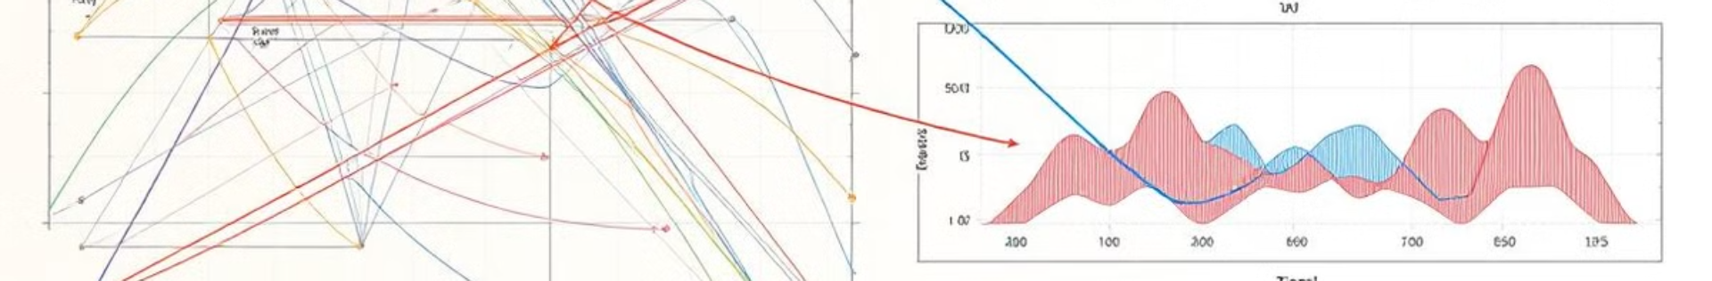
Building the Recommendation Engine: Algorithms and Techniques
Cosine Similarity: Measures the angle between movie vectors, finding similar movies based on their features.
K-Nearest Neighbors: Finds users with similar preferences and recommends movies liked by those neighbors.
1
2
3
Matrix Factorization: Decomposes user-movie ratings into latent factors to predict unseen ratings and find recommendations.

Slide 6
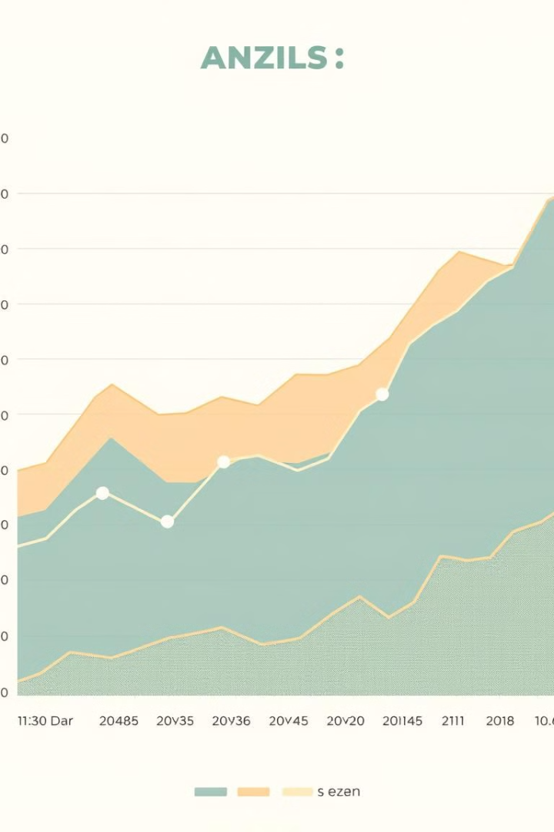
Evaluating Recommendation Performance: Metrics and Benchmarking
10
50
Precision
Recall
Measures the proportion of recommended movies that are relevant.
Measures the proportion of relevant movies that are recommended.
100
F1-Score
Combines precision and recall into a single metric.

Slide 7



Incorporating User Feedback: Improving the Recommendation System
User Ratings
1
Collecting user ratings allows the system to learn from user feedback.
Clickstream Data
2
Analyzing user browsing behavior, such as clicking on recommendations, provides valuable insights.
Explicit Feedback
3
Allowing users to provide feedback on specific recommendations, such as "like" or "dislike" buttons, helps personalize results.

Slide 8
Deploying the Recommendation System: Challenges and Best Practices
Scalability
1
The system needs to handle large amounts of data and users efficiently.
Real-time Recommendations
2
Providing recommendations quickly, ideally in real time, is crucial for user experience.
Security
3
Protecting user data and ensuring the security of the recommendation system is paramount.

